Slide 1
GameSystemObjects Documentation
John Garner, Tyler Stanton, Placidie Mugabo,
Bailey Costello, Alan Farmer

Slide 2
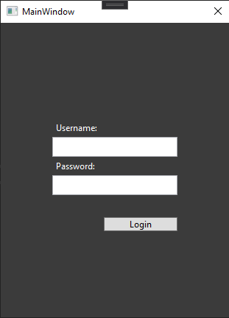
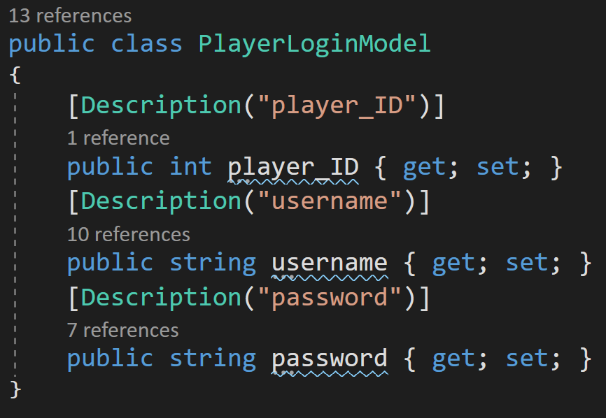
PlayerLoginModel
Class to hold data used to login a user.
Holds the
player_ID
Username
password.

Slide 3
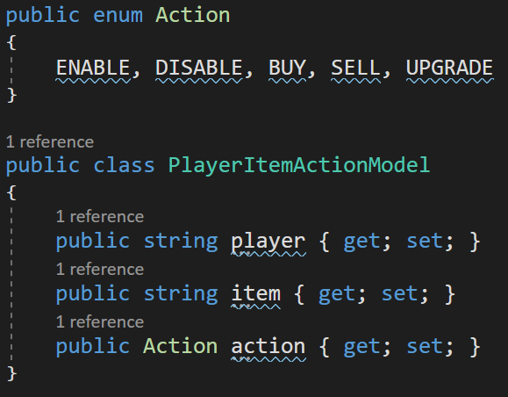
PlayerItemActionModel- Holds a enumerator and class.
Class that holds data for communicating actions players take on certain task.
enum **Action** - Represents possible actions for each task.

Slide 4
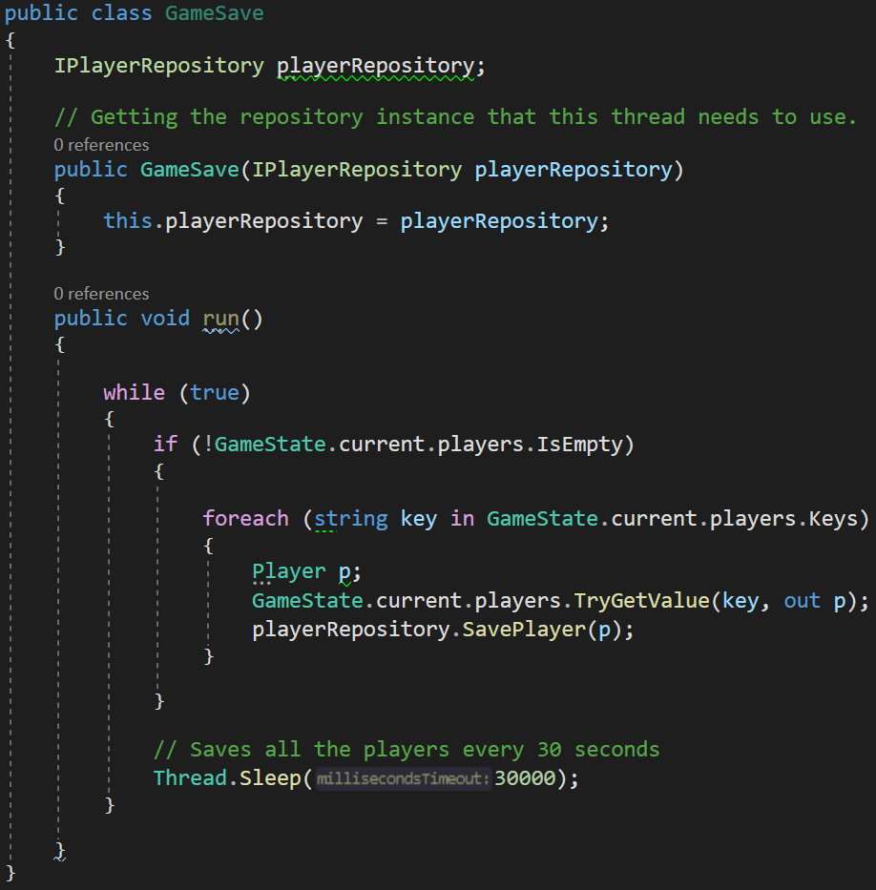
Game.cs
Gameloop - Main game loop. While running, checks that there are players and loops through each player to increment all of their items.
UpdatePlayerGameSpeed - Updates each player’s time calculation for their current item task.
GameSave - Loops through each player and saves them to the player repository every 30 seconds.
GameSave Code Example

Slide 5
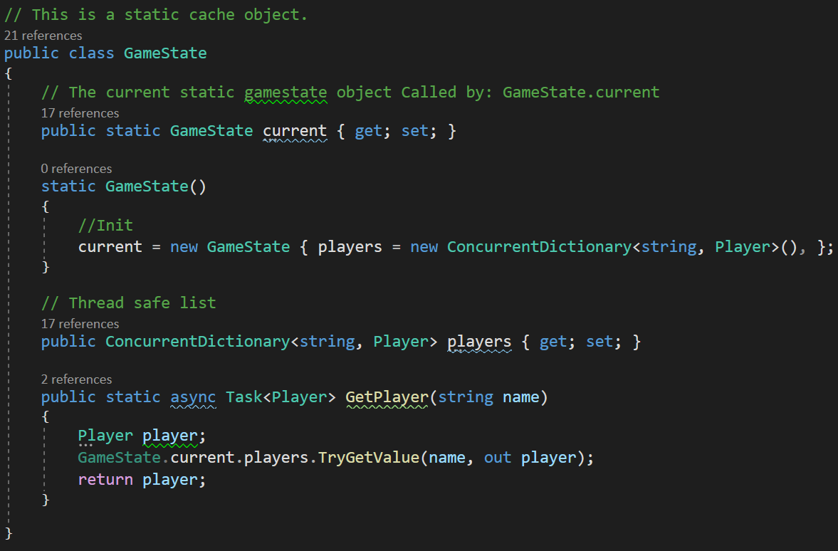
Game.cs
CleanUpSessions - Checks through each player to check if more than a minute has passed since their last seen time. If so, it saves and tries to remove the player from the current repository.
Game - Builds both the GameLoop and CleanUpSessions threads.
GameState - Static cache object with a current gamestate and thread safe list.
GameState Example Code

Slide 6
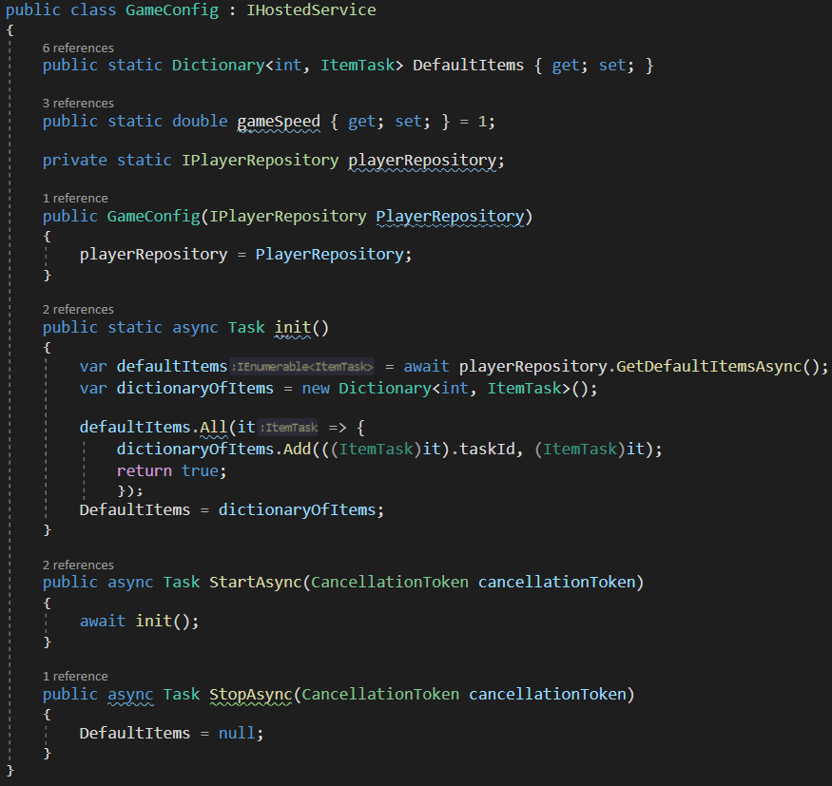
GameConfig.cs
Defines objects:
Dictionary DefaultItems
double GameSpeed
playerRepository
class GameConfig
Task init
Task StartAsync
Task StopAsync

Slide 7
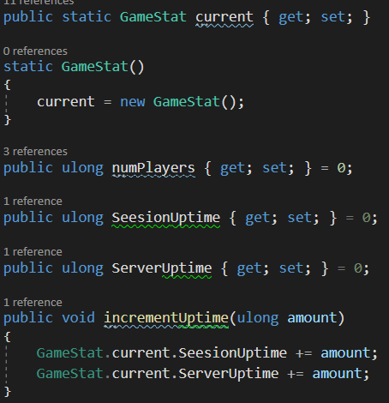
GameStat.cs
Defines classes to track game statistics:
numPlayer - number of players
SessionUpTime - Players time online
ServerUpTime - Time the server has been online
globalItemTaskStats - Dictionary of ItemStat
globalItemTaskLeaderBoard - Key value pair dictionary to create a leaderboard of players items.

Slide 8
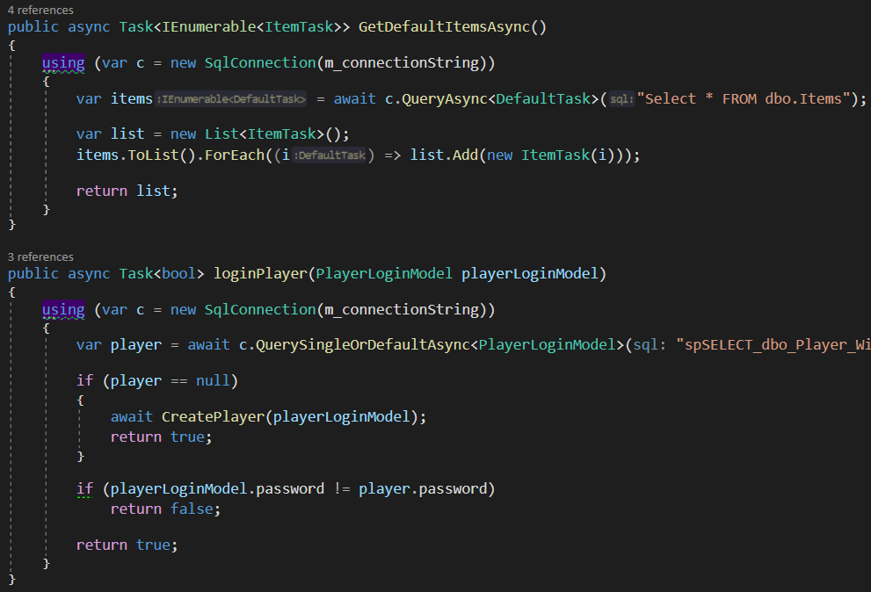
PlayerRepository.cs
Defines task objects in PlayerRepository
GetPlayer - Requests players information from the database
SavePlayer – saves a player
GetDefaultItemsAsync - Requests default items from the database
loginPlayer - Requests and compares login information
CreatePlayer - Adds a new player to the database
RemovePlayer - Removes a player from the database
GetStats - WIP
PlayerRepository Example Code

Slide 9
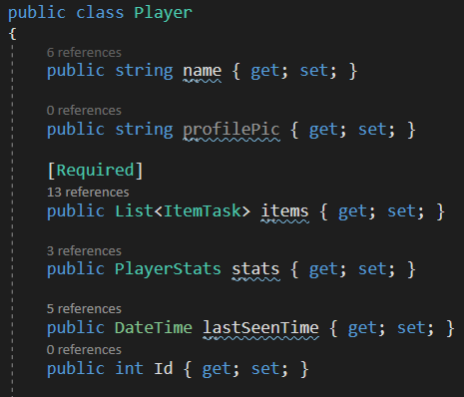
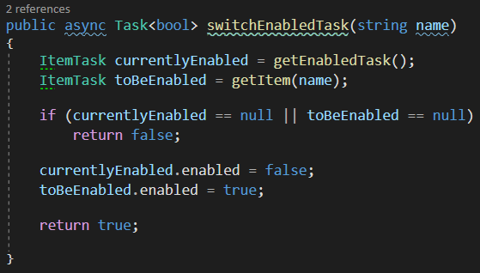
Player.cs
Class for players information.
Holds Task for interacting with the itemTasks. It also has player’s lastSeenTime.

Slide 10
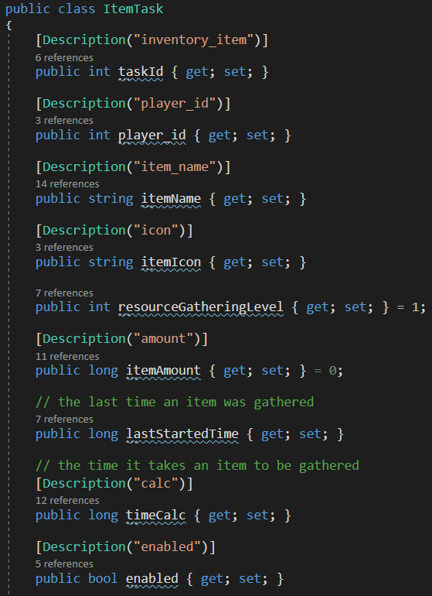
ItemTask.cs
Object that holds all task data.
taskId - Task ID for Database, int
itemName - Item/Task name, string
itemIcon - Location for Item/Task Icon, string
resourceGatheringLevel - The upgrade level of the task, int
itemAmount - Amount of this item this player has, long
lastStartedTime - The last time an item was gathered, long.
timeCalc - The time it takes for the task to complete and add to itemAmount, long.
enabled - Whether the task is running or not, bool.
upgradeGatheringLevelCost - Method to determine the upgraded cost of this task, int.

Slide 11
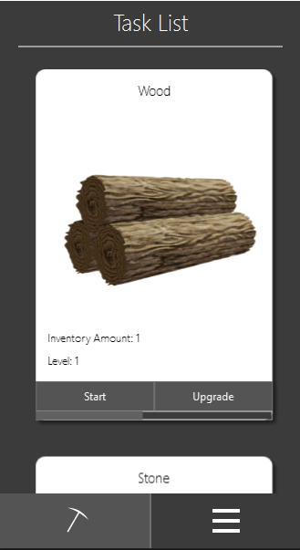
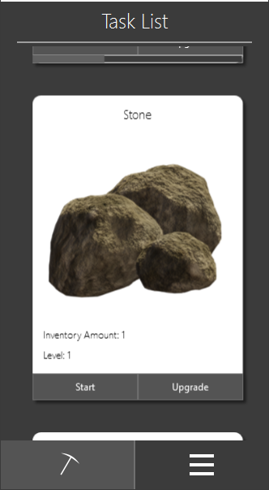
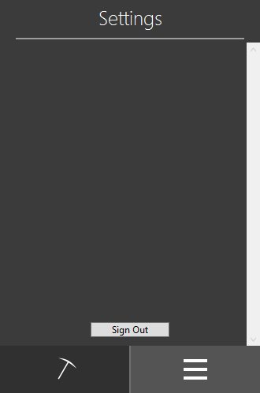
App Main Screens While Running:
Settings Not Implemented

